Slide 1

Case study 2: Analyzing and predicting employee attrition
Authored and Presented by Adam Alidra

Slide 2

Agenda
Executive Summary
Employee Attrition by the Numbers
Exploratory Data Analysis
Predicting and Classifying Attrition
Predicting Employee Monthly Incomes
Summary, Proposal, and Next Steps

Slide 3
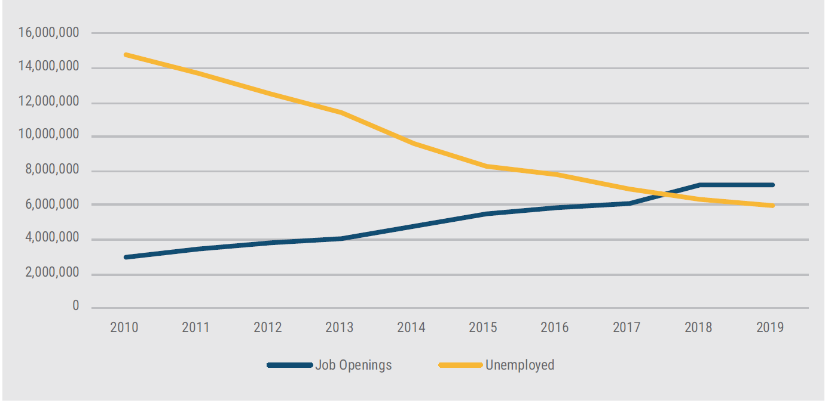
Executive summary
Employee Attrition Data Set-at-a-Glance
870 unique employees with 36 unique attributes analyzed
Industry-Wide Findings of Employee Attrition
“According to LinkedIn, an average annual worldwide employee turnover rate is 10.9%”¹
“87% of HR leaders consider improved retention a critical or high priority for the next five years” ²
“A report from the Center for American Progress found that turnover can cost organizations anywhere from 16% to 213% of the lost employee’s salary” ³
Top reasons for employee turnover, included career development, work-life balance, manager behavior, job characteristics , and well being ⁴
Supply and Demand ⁴
¹https://www.talentlyft.com/en/blog/article/242/hr-metrics-how-and-why-to-calculate-employee-turnover-rate#:~:text=According%20to%20the%20U.S.%20Bureau,above%20the%20average%20turnover%20rates.
² https://blog.bonus.ly/10-surprising-employee-retention-statistics-you-need-to-know
³ https://medium.com/hr-blog-resources/infographic-7-key-employee-turnover-statistics-135ab82090b1
⁴ https://info.workinstitute.com/hubfs/2020%20Retention%20Report/Work%20Institutes%202020%20Retention%20Report.pdf
Notes:
Work Institutes 2020 Retention Report: Supply and Demand (intersection between job openings and unemployed)
The continuation of this trend fuels the war for talent in the U.S. job market. Employers are faced with the challenge of attracting employees from other companies rather than the easier task (several
years ago) of recruiting them from a ready unemployed supply.

Slide 4

Employee attrition by the numbers
Findings:
730 employees remained with their employer (83.9%)
140 employees left their employer (16.1%)

Slide 5
Exploratory data analysis

Slide 6
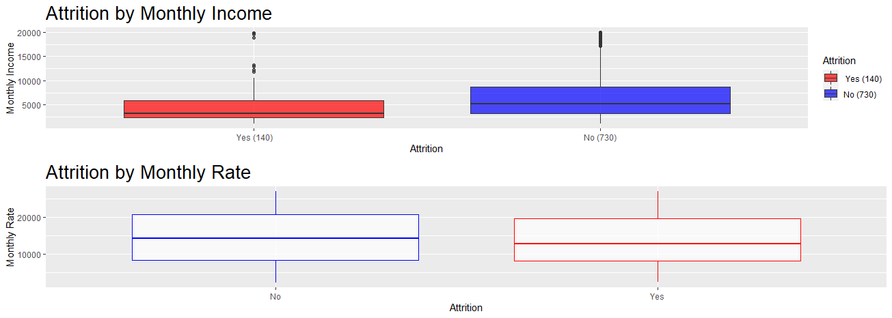
Comparison of attrition to monthly income vs monthly rate
Notes:
Here we can clearly see a correlation between lower monthly incomes and attrition with a positively skewed distribution, especially on the ‘yes’ boxplot.
Conversely, attrition by monthly rate shows a relatively even distribution across both ‘no’ and ‘yes’ boxplots. The monthly rate and more broadly speaking, rate attributes, further create confusion without an understanding of what they signify as there doesn’t appear to be a mathematical correlation when comparing hourly, daily, and monthly rates- hence going forward, we will focus on monthly income and the other variables provided in the study. Hi Peter, I'm officially stuck working through a case study (final project) for my first master of science data science class- case study is on employee attrition. I've done the EDA but can't get my k-nn model to work to classify attrition values. Then I need to do a linear regression model and any others to compare results and predict monthly income

Slide 7
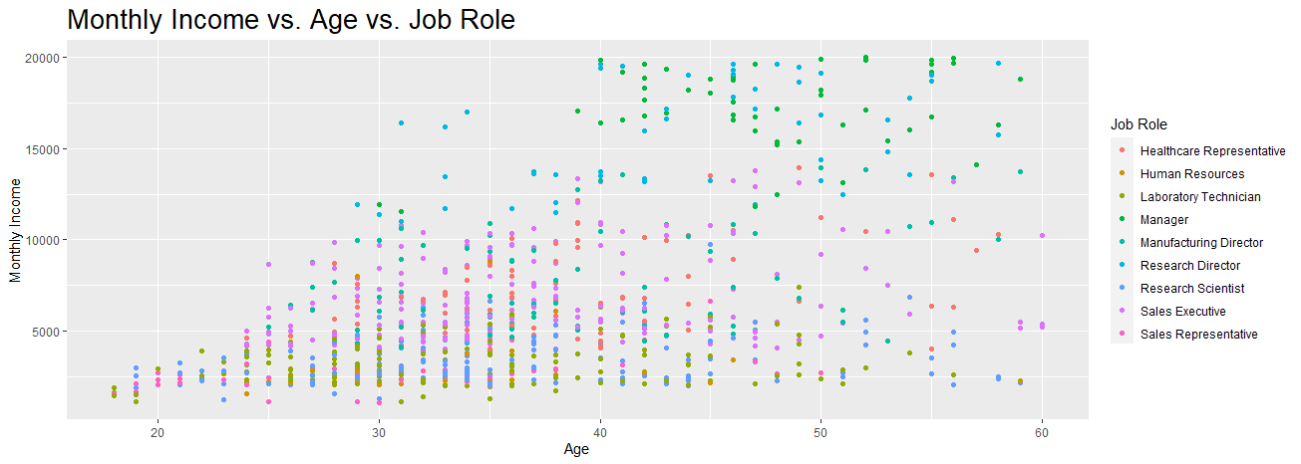
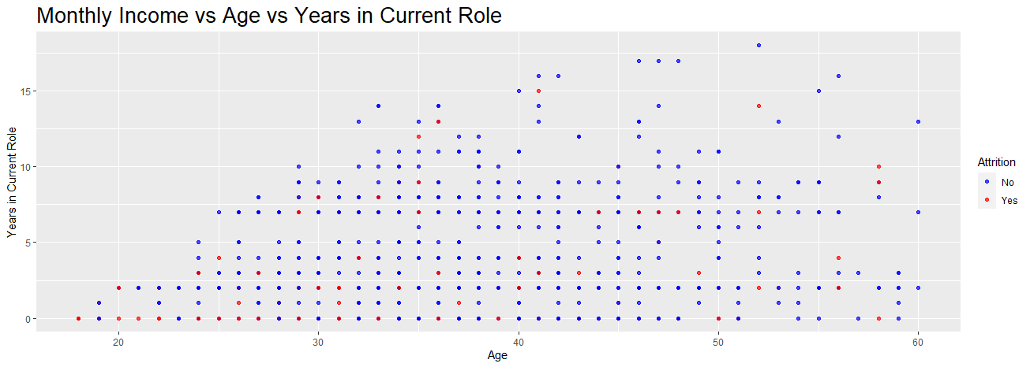
understanding attrition patterns: Analysis of monthly income, age, job role and tenure

Slide 8
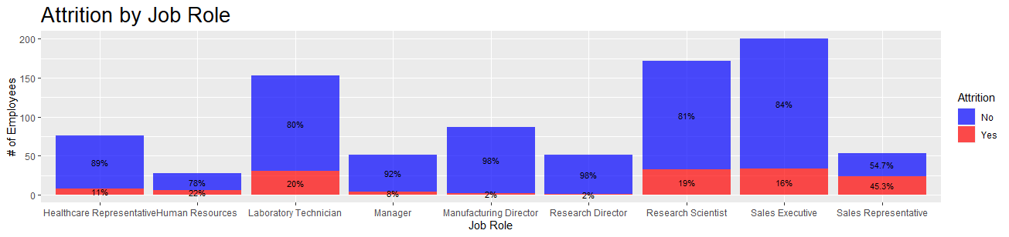
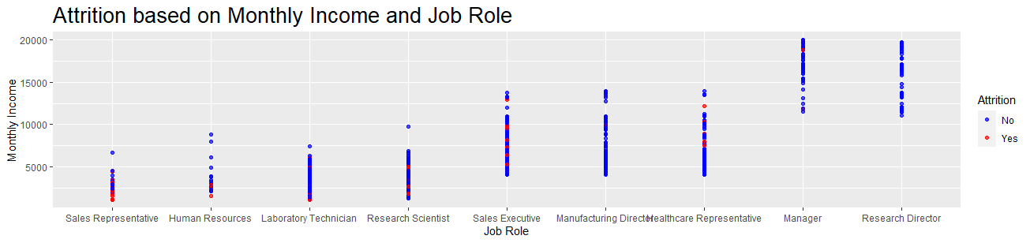
Attrition respective to job role and monthly income
Findings:
Sales Representatives, Lab Technicians, and HR have highest attrition rates
Sales Representatives, Lab Technicians, and HR also are in the lower end of monthly income amongst all job role types
Conversely, manager and director roles tend to have the lowest attrition and also higher pay

Slide 9
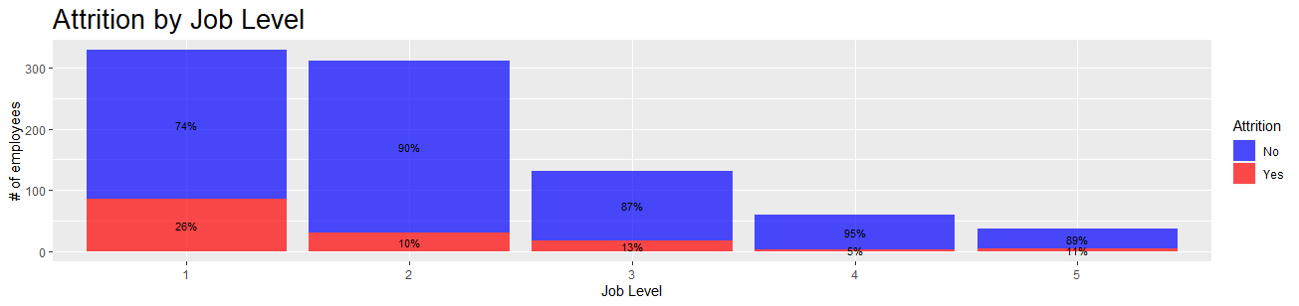
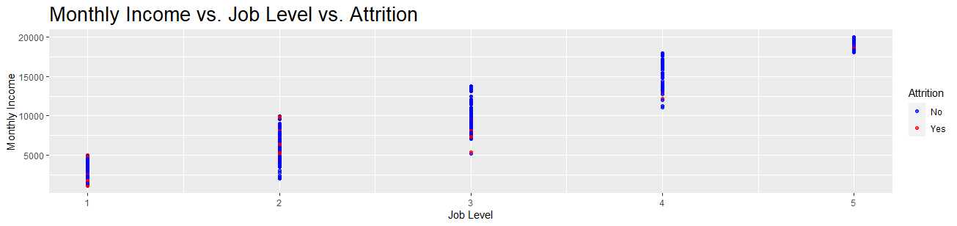
Attrition respective to job level and monthly income
Findings:
Employees at a lower job level tend to have higher attrition versus those with higher job levels
There appears to be a positive correlation between job level to monthly income

Slide 10
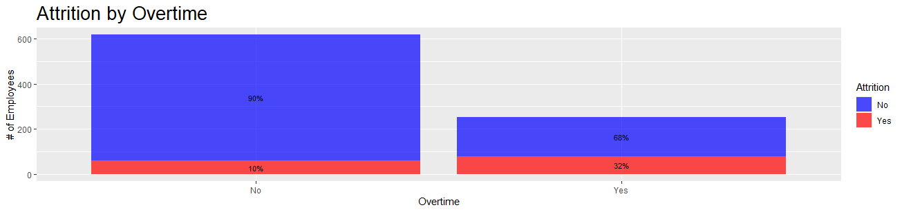
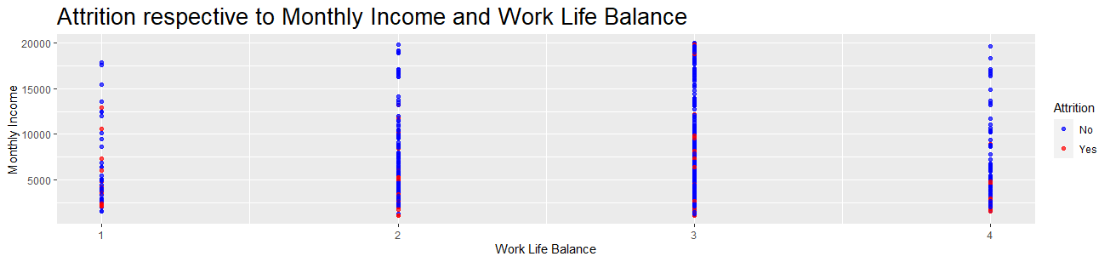
Work and quality of life analysis
Findings:
Those that worked overtime had higher attrition rates over those that did not
Those that had lower incomes and lower work life balances had higher attrition rates than those with higher incomes; however, it appears the more compelling factor was monthly income (over work life balance)

Slide 11
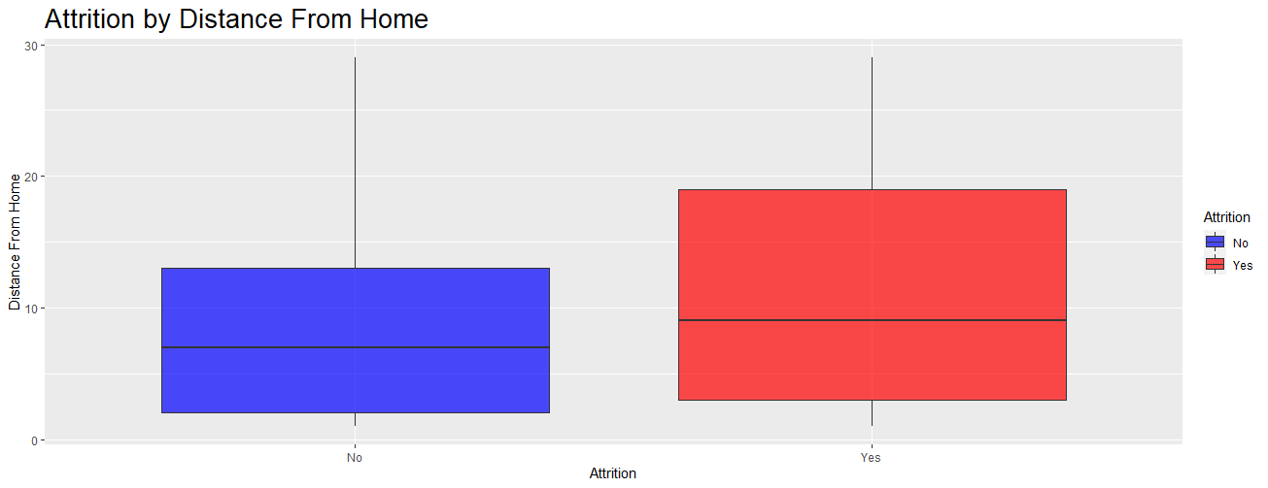
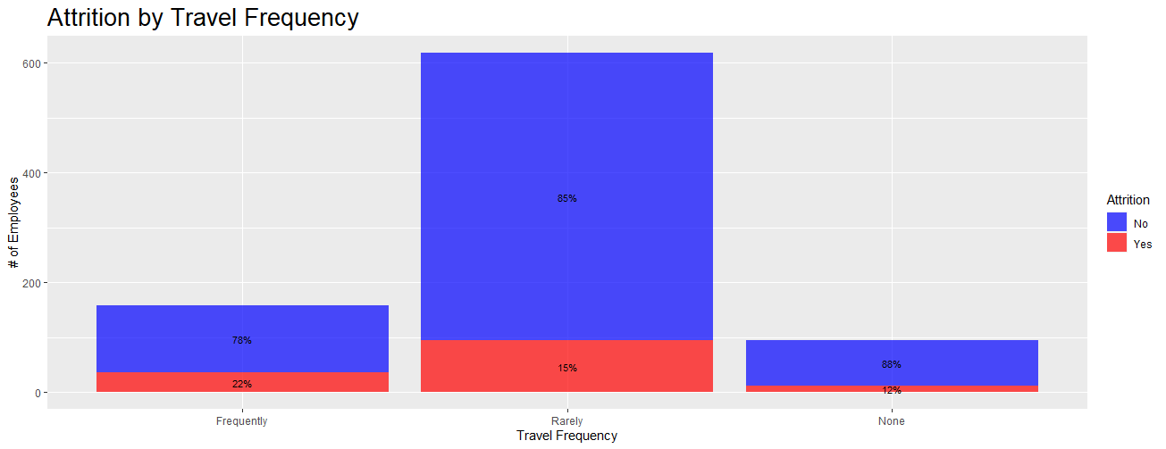

Attrition by distance from home
Findings:
Employees with further commutes have higher attrition rates
Those that travel more frequently for business have higher attrition rates than those that rarely do or don’t at all

Slide 12
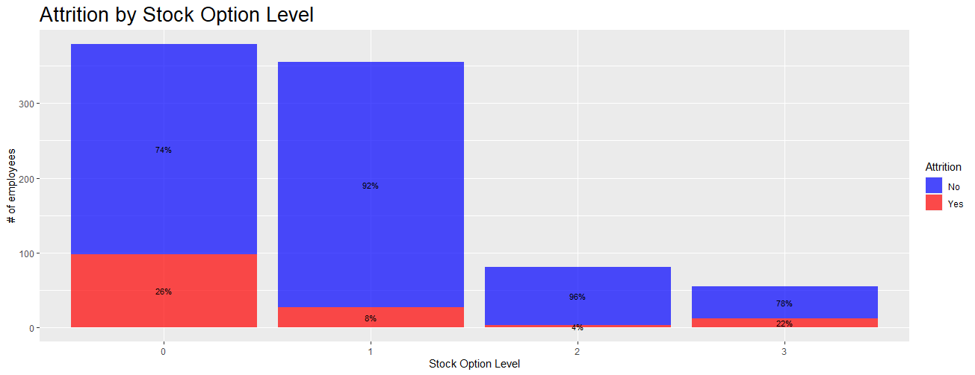
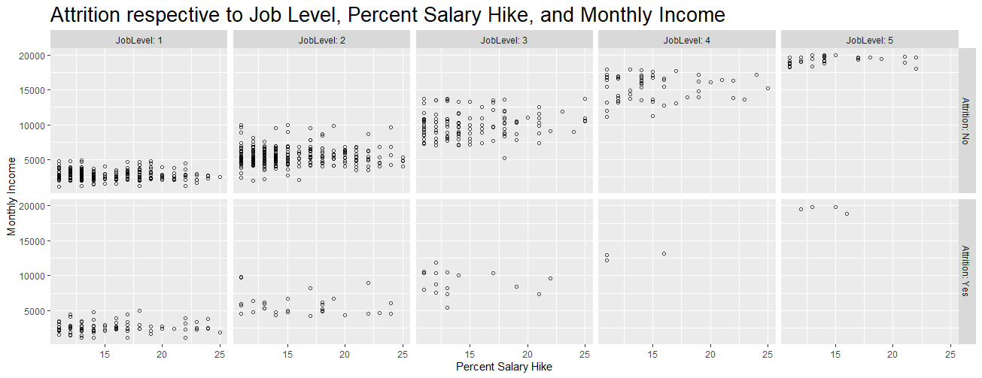

Attrition related to other compensation
Findings:
Those with no stock options have higher attrition rates than those with levels 1&2; attrition increases with stock option level 3
There’s a positive correlation across multiple compensatory variables
Notes:
Attrition increases with stock option level 3- one may speculate that occurs due to individuals retiring

Slide 13
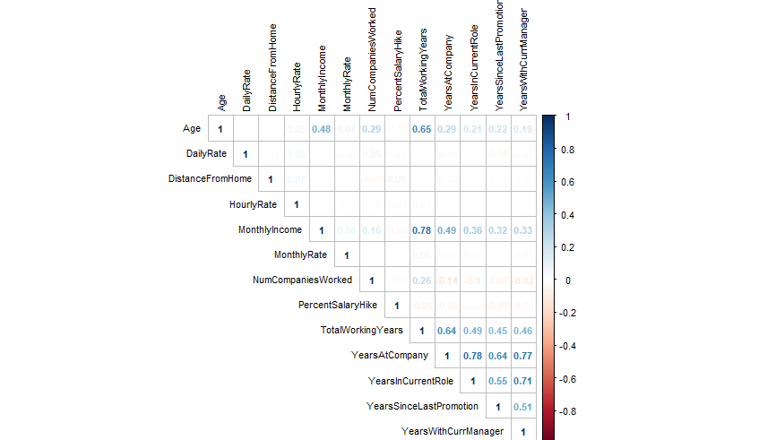
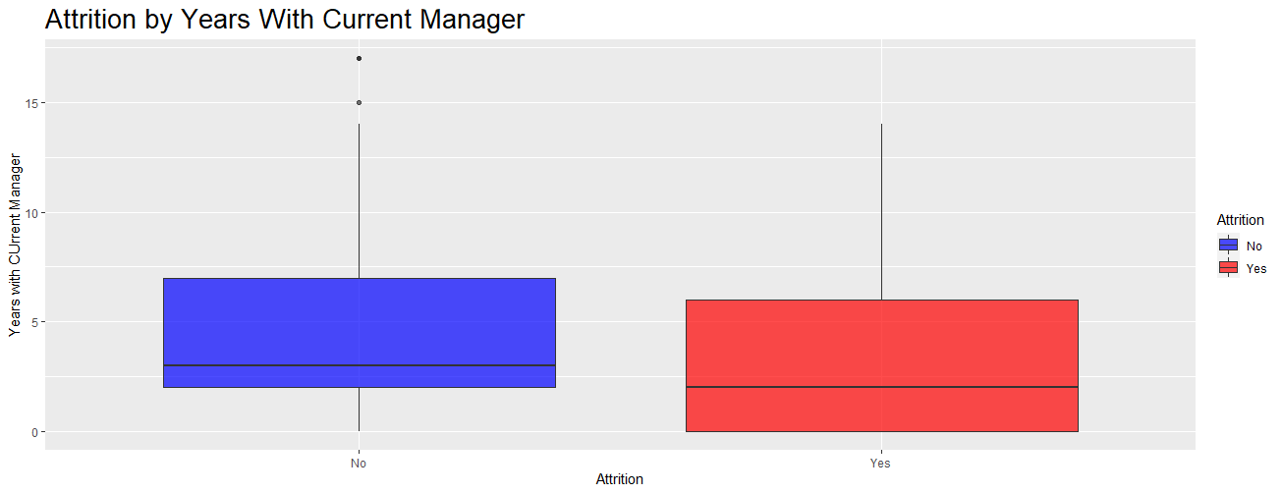
Attrition by years with current manager and multicollinearity
Findings:
Employees that remain with their current manager for longer have lower attrition rates than those with less
Multicollinearity chart illustrates:
Positive correlation between monthly income and total working years
Negative correlation between # of companies worked and years under current manager

Slide 14
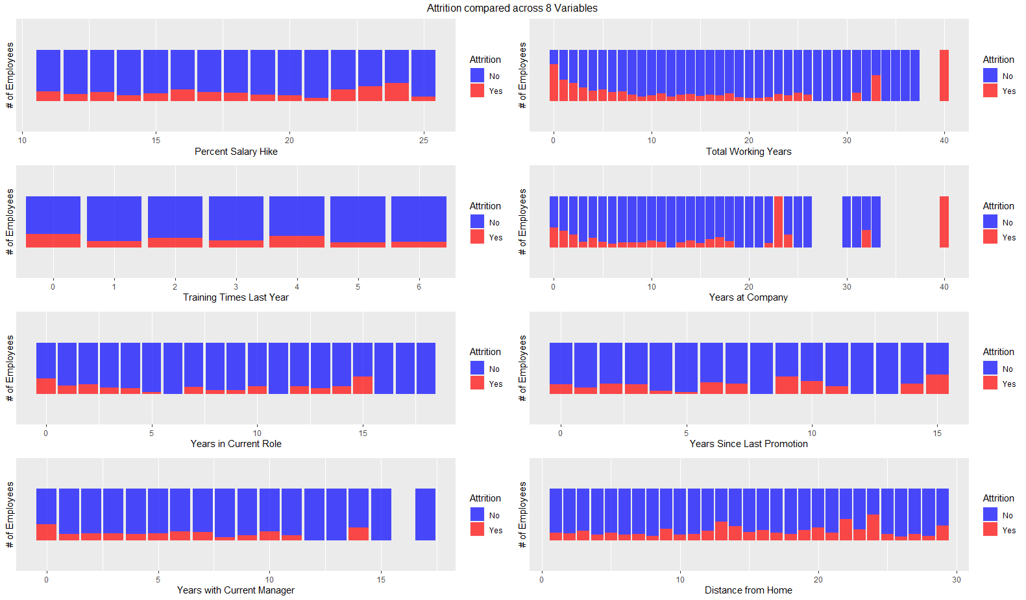
Exploratory analysis- summary view

Slide 15
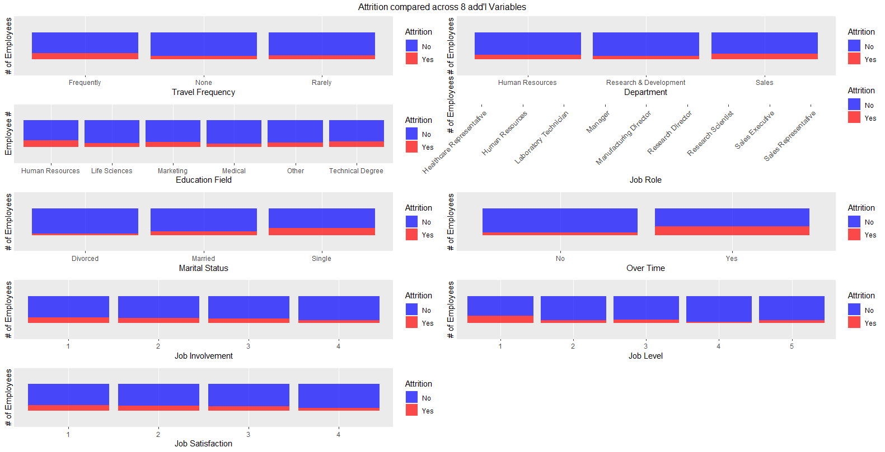
Exploratory analysis- summary view (continued)
Exploratory Data Analysis Conclusion:
Education, performance ratings, training times last year, department, and gender variables have marginal bearing on attrition
Indicators of attrition include, but not are limited to, monthly income, commute, both distance from work and travel frequency, job level, and stock option

Slide 16
Classification and prediction

Slide 17
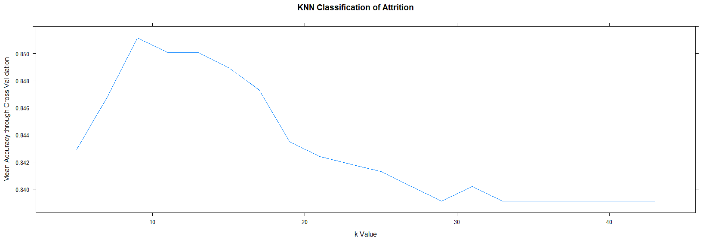
Classification of Attrition: K-Nn model
Sample size of 609 samples tested 3 times with a fold factor of 10
Scope: 30 predictors
K=9
Result: Mean Accuracy of 84.29% (or 220) attrition classification was identified correctly
‘Yes’ had a very low sensitivity score of 4.76% (2), although ‘No’ was properly classified 99.5% (218) of the time
Notes:
Dichotomous outcome variables
The model performed the fitting procedure a total of 10 times
For kNN, we use the test data to determine the right value of K and train the nearest neighboring values ultimately to help us understand the accuracy that, attrition actually did or did not occur corresponding to the employee and their corresponding attributes

Slide 18
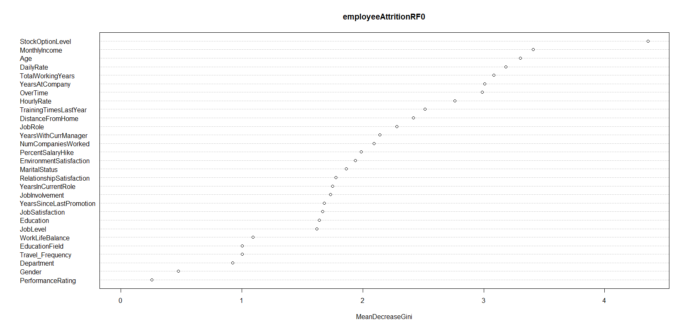
classification of top attrition predictors: Random forest Model
Sample 1:
Mean Accuracy- 80.08%
Sensitivity: 67%
Specificity: 82.65%
Sample 2:
Mean Accuracy: 84.29%
Sensitivity: 59.5%
Specificity: 89.04%

Slide 19
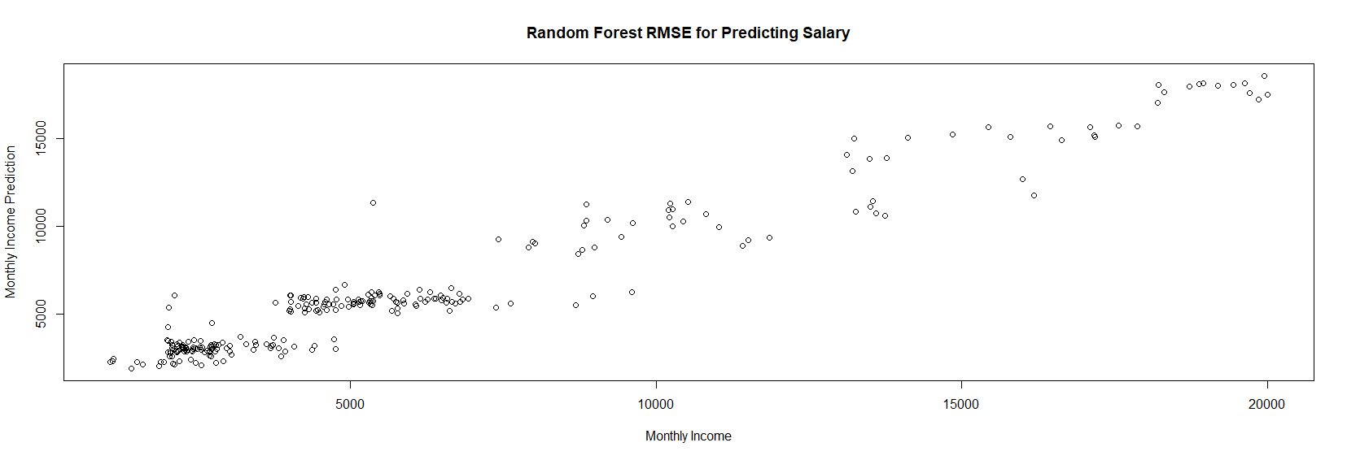
Predicting salary: random forest model
RMSE of $1240.673
Notes:
Root mean square error representing the difference between known values i.e. monthly income versus those we are interpolating based off the provided empirical data

Slide 20
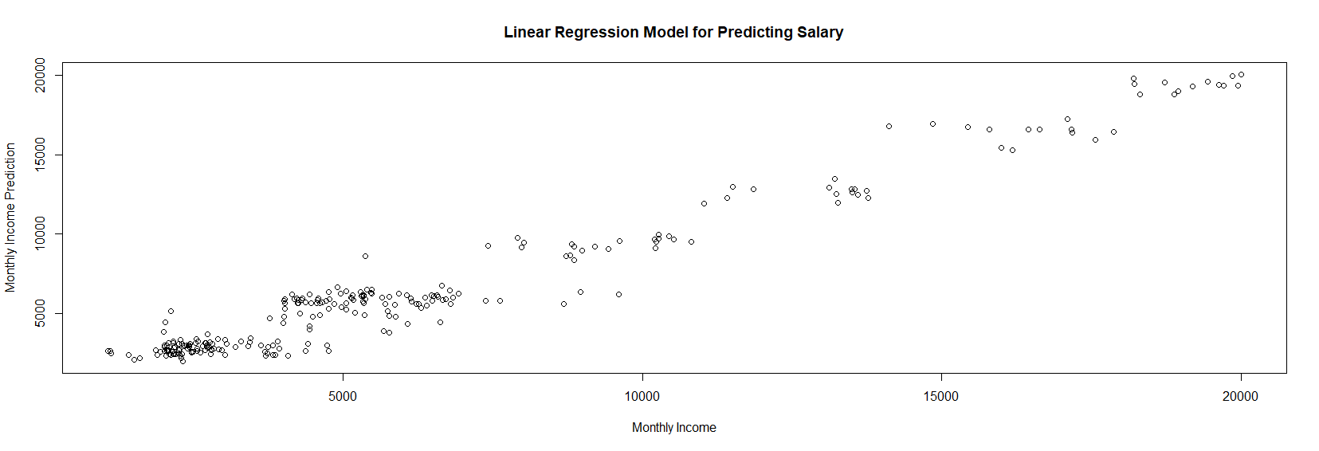
Predicting salary: Linear regression model
Generally normal distribution between predicted monthly income and monthly income
RMSE of $1023.69
Adjusted R-Squared: .59
Originally .95 prior to adjusting to top predictors

Slide 21
Summary, proposal, and next steps
Top predictors include: Stock Option Level, Monthly Income, Age, Total Working Years, and Years Working at Company
In classifying attrition based off other employee attributes, the random forest model produces a more accurate representation of the likelihood of attrition amongst employees
In predicting salary of an employee, using both random forest and linear regression models, the linear regression model produces a more accurate prediction
Empirical data, by and large, aligns with macro and even global employee attrition trends, albeit the data set provided has slightly higher attrition than the global average
Proposal and Next Steps:
Closer alignment with HR and financial business units to:
Understand ambiguous data categories, including ‘rate’ attributes as well as real world nuances
Better understanding of cost-basis related to employee salaries to determine when, where, and how investments should be placed in employee attrition

